Slide 1


health
Assessment
Assess Today, Thrive Tomorrow.

Slide 2
Introduction To Team
Prajapati Shalinkumar H.
Mori VishwajeetSinh D.
Prajapati Zeelkumar M.
Rathod Navnitkumar A.

Slide 3

Introduction: Our commitment to your well-being
Health assessment plays a critical role in monitoring individuals' well-being.
The goal of the project is to develop a Python-based application to assess and analyze health .
This tool helps in tracking key indicators like BMI, heart rate, and other health parameters to give insights into an individual’s health status..

Slide 4

Overview
The system collects user health information such as glucose level, blood pressure, BMI, and age.
It processes the data using ML models and predicts whether a user is at risk of diabetes or heart disease.
Users can store and review their health records for future reference.
The system ensures secure storage of data in a database.

Slide 5
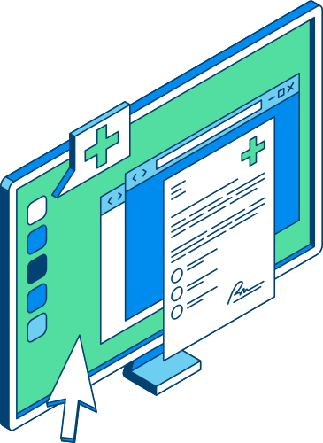
Technologies Used
Programming Language:
Python (for ML and backend processing)
Libraries & Frameworks:
Pandas, NumPy, SK-Learn (for ML)
Flask :
Used for connections
Machine Learning Models:
SVM , Decision Tree, etc.

Slide 6

Functionalities of the System
Viewing Prediction History
Entering Health Data
Health Risk Prediction
Users can check past health records and results.
Users provide details like glucose level, blood pressure, and BMI.
The system analyzes data and predicts diabetes or heart disease risk.

Slide 7
Merits
of the System
01.
Instant Health Predictions
Quick risk assessment without waiting.
02.
24/7 Availability
Can be used anytime, anywhere.
03.
Reduces Hospital Load
Helps doctors focus on critical cases.
04.
Cost-Effective
Saves money on unnecessary doctor visits.
05.
Encourages Preventive Care
Helps users take early action for better health.

Slide 8

Demerits
of the System
01.
Prediction Accuracy May Vary
The model depends on input data
02.
Limited Disease Coverage:
Currently focused on diabetes and heart disease only.
03.
Needs Internet Access
Cannot work offline.
04.
Not for Emergency Cases
Cannot handle real-time critical health conditions.

Slide 9
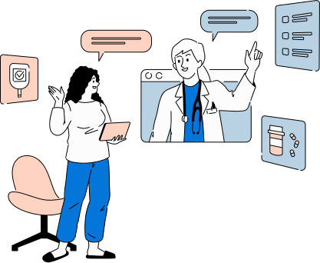
Future Scope of the System
Support for More Diseases
Expand predictions to other health conditions like kidney or liver diseases.
Real-Time Health Monitoring
Integrate with smartwatches and wearable devices.
AI Chatbot Assistance
Provide instant health tips and recommendations.
Better Accuracy with AI
Improve predictions using advanced machine learning models.
Integration with Hospitals
Allow doctors to access patient records for better diagnosis.
Health Reminder System
Notify users about regular checkups, diet plans, and fitness routines.

Slide 10
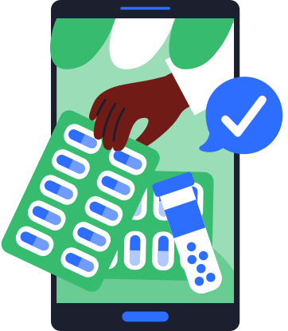
Thank you very much!

